Slide 1

COURSE SLIDES
Certified Lean Six Sigma Green Belt (CLSSGB) Training
WSQ Course Code: TGS-2025055775
Conducted by Tertiary Infotech Academy Pte Ltd | UEN 201200696W
Version 1
(c) 2026 Tertiary Infotech Academy Pte Ltd. All rights reserved.

Slide 2
ADMIN
Copyright
- Copyright (c) 2026 Tertiary Infotech Academy Pte Ltd. All rights reserved.
- No part of this courseware may be reproduced or distributed without written permission.
- Learners may use the materials for personal learning during this WSQ course.
- All trademarks and product names belong to their respective owners.
Certified Lean Six Sigma Green Belt (CLSSGB) Training | TGS-2025055775
(c) 2026 Tertiary Infotech Academy Pte Ltd
2

Slide 3
YOUR TRAINER - GENERAL
About the Trainer
NAME
TITLE / DESIGNATION
?
QUALIFICATIONS
Your Trainer
AREAS OF EXPERTISE
General Trainer template - to be completed by the trainer
TRAINING & INDUSTRY EXPERIENCE
CONTACT
Certified Lean Six Sigma Green Belt (CLSSGB) Training | TGS-2025055775
(c) 2026 Tertiary Infotech Academy Pte Ltd
3

Slide 4
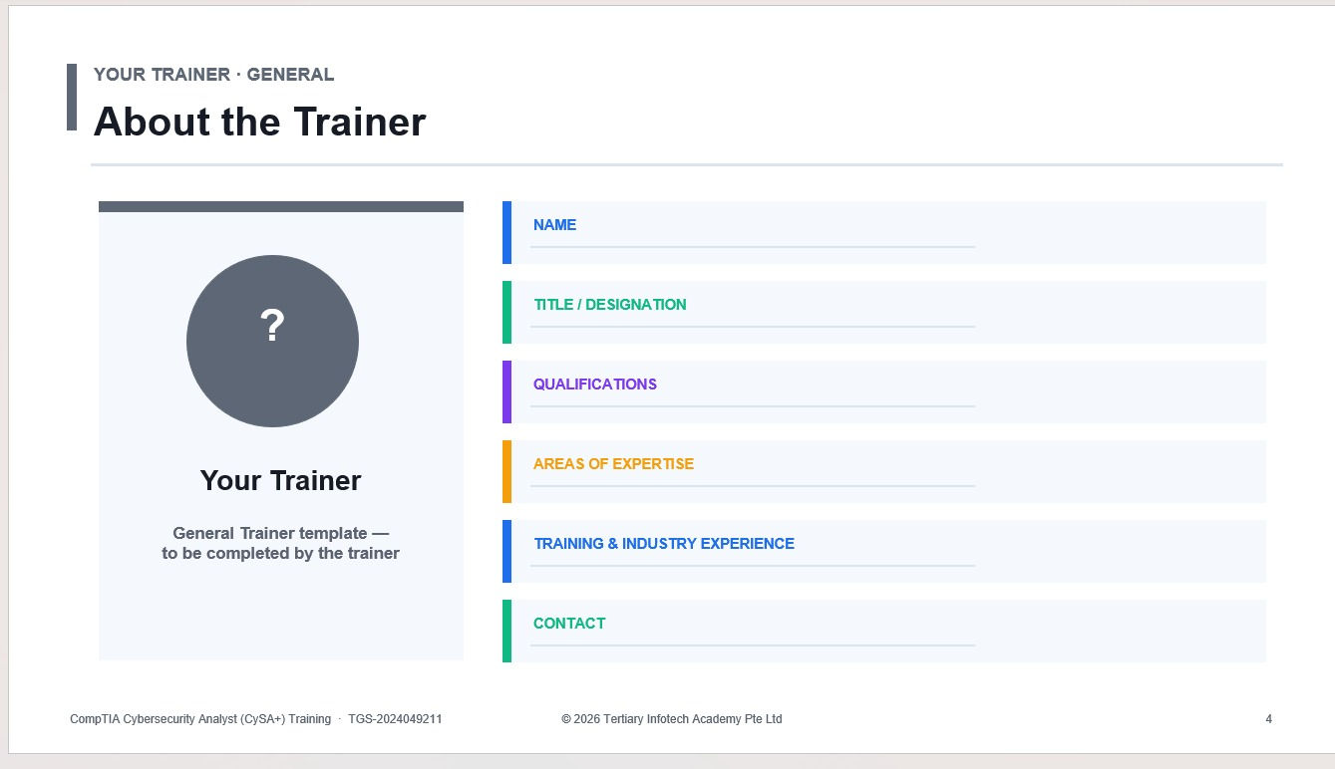
REFERENCE SCREENSHOT
About the Trainer - Reference Template
Certified Lean Six Sigma Green Belt (CLSSGB) Training | TGS-2025055775
(c) 2026 Tertiary Infotech Academy Pte Ltd
4

Slide 5
YOUR TRAINER
About the Trainer
ROLE
Principal Trainer, Tertiary Infotech Academy Pte. Ltd.
AA
QUALIFICATIONS
PhD - specialises in AI, automation and software engineering.
DELIVERS
Dr. Alfred Ang
WSQ courses on Lean Six Sigma, AI automation and app development.
Principal Trainer Tertiary Infotech Academy Pte. Ltd.
FOUNDER
Founder and lead instructor at Tertiary Infotech / Tertiary Courses.
Certified Lean Six Sigma Green Belt (CLSSGB) Training | TGS-2025055775
(c) 2026 Tertiary Infotech Academy Pte Ltd
5

Slide 6
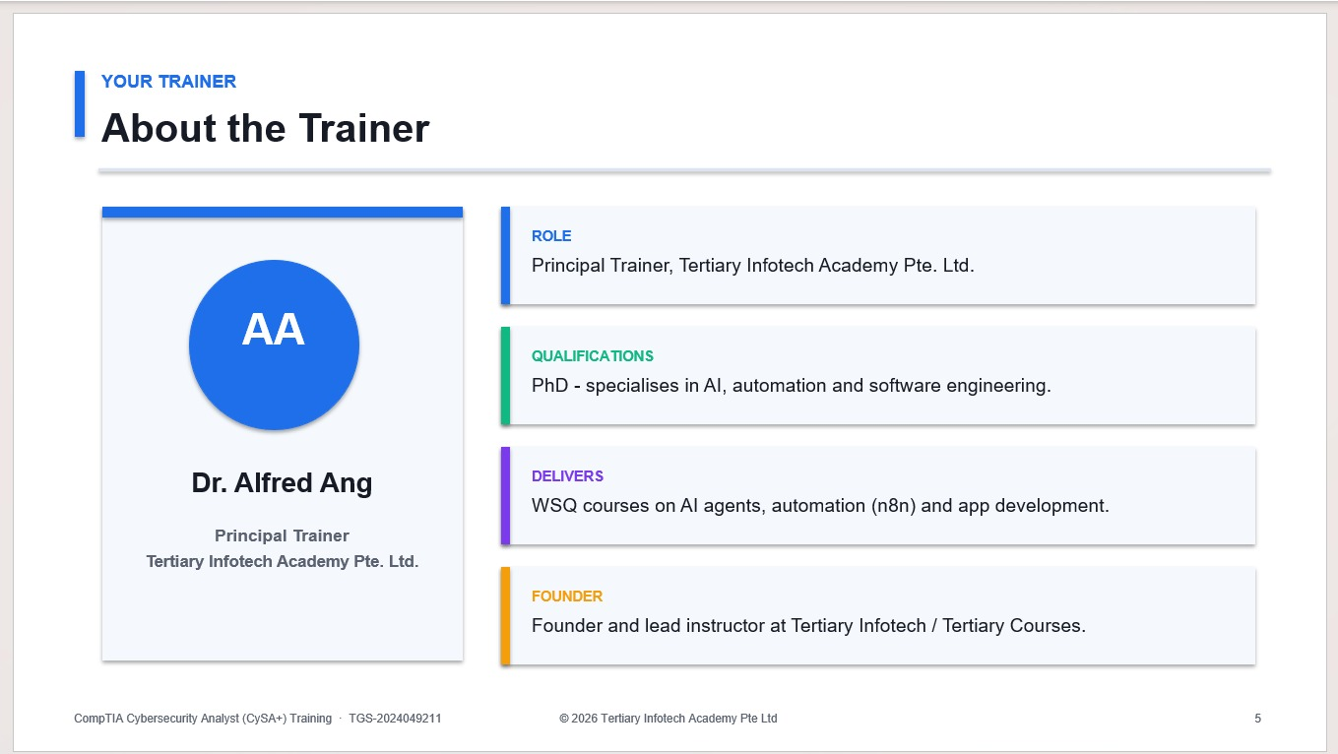
REFERENCE SCREENSHOT
About the Trainer - Reference Example
Certified Lean Six Sigma Green Belt (CLSSGB) Training | TGS-2025055775
(c) 2026 Tertiary Infotech Academy Pte Ltd
6

Slide 7
ADMIN
Course Agenda
- Day 1: Lean Six Sigma basics, project selection, SIPOC, process mapping, facilitation, A3, KPIs and baseline charts.
- Day 2: Basic statistics, capability, root cause analysis, FMEA, countermeasures, control plan and project close.
- Final session: A3 presentation readiness, assessment briefing and course wrap-up.
Certified Lean Six Sigma Green Belt (CLSSGB) Training | TGS-2025055775
(c) 2026 Tertiary Infotech Academy Pte Ltd
7

Slide 8
HOUSEKEEPING
Ground Rules
1
Set your mobile phone to silent mode.
2
Participate actively - no question is too small.
3
Mutual respect: agree to disagree.
4
One conversation at a time.
5
Be punctual; return from breaks on time.
6
75% attendance is required.
Certified Lean Six Sigma Green Belt (CLSSGB) Training | TGS-2025055775
(c) 2026 Tertiary Infotech Academy Pte Ltd
8

Slide 9
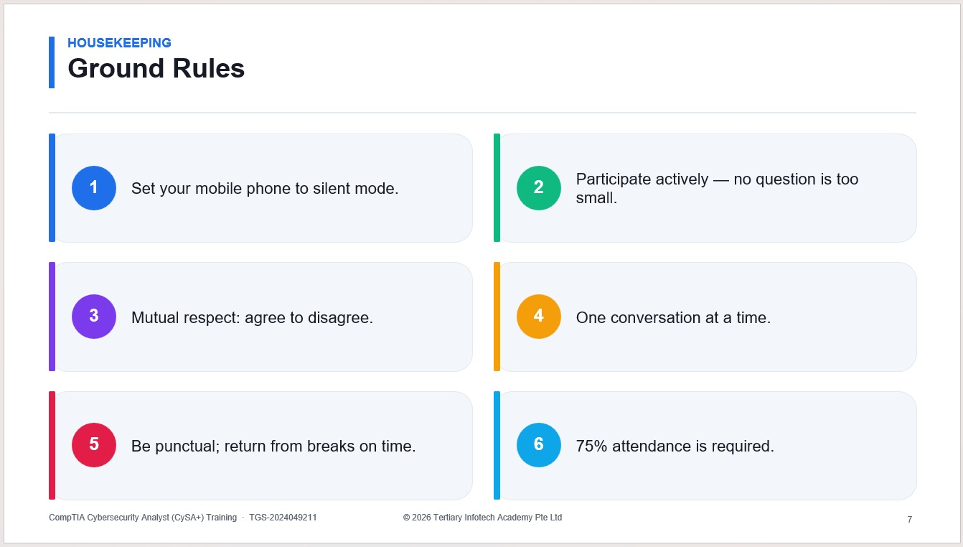
REFERENCE SCREENSHOT
Ground Rules - Reference Example
Certified Lean Six Sigma Green Belt (CLSSGB) Training | TGS-2025055775
(c) 2026 Tertiary Infotech Academy Pte Ltd
9

Slide 10
ADMIN
Learning Outcomes
- Explain Lean, Six Sigma, DMAIC, COPQ, Kano and Green Belt responsibilities.
- Select and scope a suitable improvement project.
- Create SIPOC, process maps, stakeholder analysis, Kaizen plan and A3 report.
- Define KPIs, collect baseline data and build run/Pareto charts.
- Apply basic statistics, root cause analysis, FMEA and countermeasures.
- Create a control plan, response plan and project closeout presentation.
Certified Lean Six Sigma Green Belt (CLSSGB) Training | TGS-2025055775
(c) 2026 Tertiary Infotech Academy Pte Ltd
10

Slide 11
ADMIN
Digital Attendance and LMS
- Take AM, PM and assessment digital attendance when instructed by the trainer.
- Minimum attendance requirements apply for SSG-funded courses.
- Courseware and assessment instructions are provided through the LMS.
- Submit required assessment evidence before leaving the classroom.
Certified Lean Six Sigma Green Belt (CLSSGB) Training | TGS-2025055775
(c) 2026 Tertiary Infotech Academy Pte Ltd
11

Slide 12
ASSESSMENT
Assessment Flow Reminder
1
2
3
4
5
TRAQOM digital attendance
>
Assessment digital attendance
>
Sit WA then case study
>
Submit answers on the LMS
>
Sign Assessment Summary Record
The TRAQOM QR code, LMS submission and assessment evidence are handled through the LMS/TMS portal.
Certified Lean Six Sigma Green Belt (CLSSGB) Training | TGS-2025055775
(c) 2026 Tertiary Infotech Academy Pte Ltd
12

Slide 13
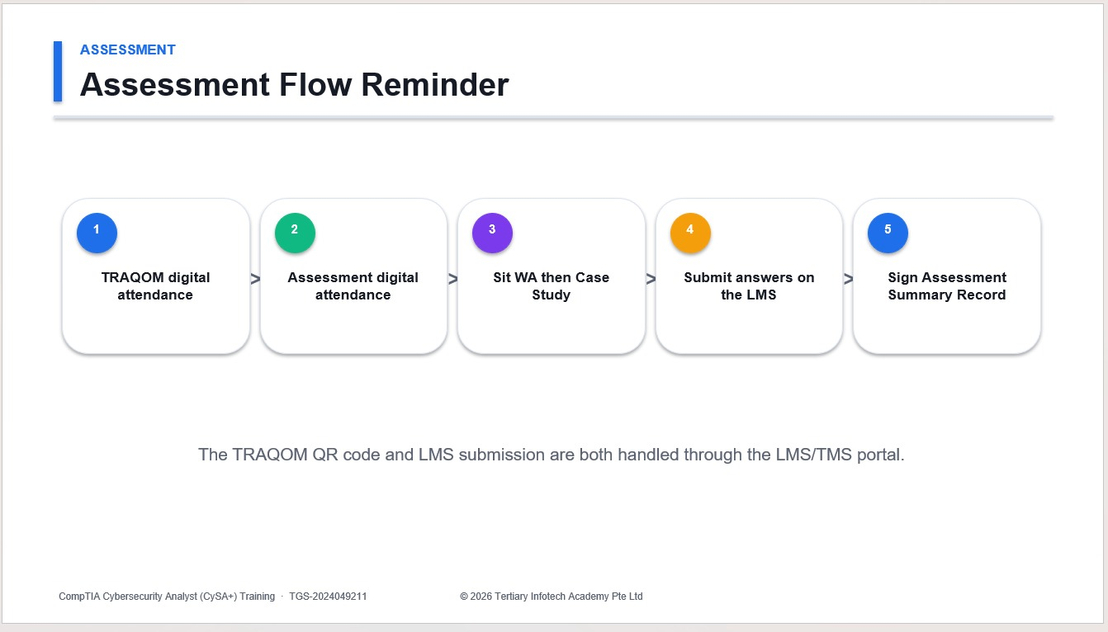
REFERENCE SCREENSHOT
Assessment Flow - Reference Example
Certified Lean Six Sigma Green Belt (CLSSGB) Training | TGS-2025055775
(c) 2026 Tertiary Infotech Academy Pte Ltd
13

Slide 14
ADMIN
Practice Project File
- Project selection worksheet, problem statement and goal statement.
- SIPOC, process map, stakeholder analysis, Kaizen plan and A3 report.
- Data collection plan, baseline data, run chart, Pareto chart and statistics worksheet.
- Root cause worksheet, FMEA, countermeasure plan, standard work and control plan.
Certified Lean Six Sigma Green Belt (CLSSGB) Training | TGS-2025055775
(c) 2026 Tertiary Infotech Academy Pte Ltd
14

Slide 15
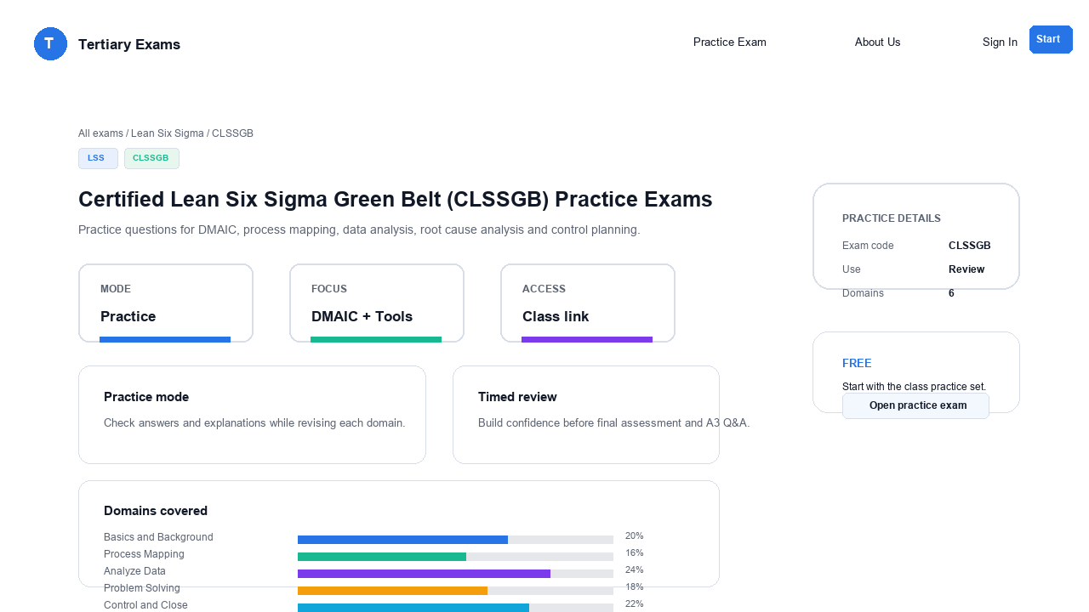
PRACTICE EXAM
Take the Online CLSSGB Practice Exams
- Reinforce all six CLSSGB domains with realistic exam-style questions before assessment day.
- Use practice sets to test DMAIC, process mapping, data analysis, FMEA and control planning.
- Review mode helps you check the correct answer and revisit the concept after each question.
- Complete the practice questions from Google Classroom, then bring difficult items to the review session.
Access and practise at: Google Classroom > Practice Exams
Certified Lean Six Sigma Green Belt (CLSSGB) Training | TGS-2025055775
(c) 2026 Tertiary Infotech Academy Pte Ltd
15

Slide 16
REFERENCE SCREENSHOT
CLSSGB Practice Exam - Course-Specific Screenshot
Certified Lean Six Sigma Green Belt (CLSSGB) Training | TGS-2025055775
(c) 2026 Tertiary Infotech Academy Pte Ltd
16

Slide 17
LEAN SIX SIGMA ROADMAP
DMAIC Project Flow
Each lab contributes one artifact to the final Green Belt A3 project story.
Define
Measure
Analyze
Improve
Control
Problem, customer, scope
Baseline and KPI data
Patterns and root causes
Countermeasures and pilots
Sustain and hand over
Certified Lean Six Sigma Green Belt (CLSSGB) Training | TGS-2025055775
(c) 2026 Tertiary Infotech Academy Pte Ltd
17

Slide 18
KEY CONCEPT
Lean and Six Sigma
Lean focus
Six Sigma focus
- Remove non-value-added work
- Reduce waiting, rework, handoffs and motion
- Improve flow and visual management
- Reduce variation and defects
- Use data to understand performance
- Protect the customer-critical output
Certified Lean Six Sigma Green Belt (CLSSGB) Training | TGS-2025055775
(c) 2026 Tertiary Infotech Academy Pte Ltd
18

Slide 19
TOOLKIT
Core Green Belt Tools
Project and process tools
Data and control tools
- Project charter and selection matrix
- SIPOC and current-state process map
- Stakeholder analysis and facilitation plan
- A3 report and Kaizen plan
- Operational definitions and KPI plan
- Run chart, Pareto chart and basic statistics
- Fishbone, 5 Whys and FMEA
- Control plan and response plan
Certified Lean Six Sigma Green Belt (CLSSGB) Training | TGS-2025055775
(c) 2026 Tertiary Infotech Academy Pte Ltd
19

Slide 20
DOMAIN 1
Basics and Background
Lean, Six Sigma, DMAIC, Green Belt role, COPQ, Kano and project selection
Certified Lean Six Sigma Green Belt (CLSSGB) Training | TGS-2025055775
(c) 2026 Tertiary Infotech Academy Pte Ltd
20

Slide 21
BASICS AND BACKGROUND
Lab 01: Lean Six Sigma Basics and Project Selection
You have been asked to support an improvement initiative. Before mapping or measuring the process, you must choose a project that is valuable, realistic, and appropriate for a Green Belt.
Objectives
Deliverables
- Explain Lean Six Sigma fundamentals.
- Describe the Green Belt role.
- Identify customer value and COPQ.
- Select a suitable improvement project.
- Project selection worksheet.
- COPQ notes.
- Kano notes.
- Draft problem and goal statements.
Certified Lean Six Sigma Green Belt (CLSSGB) Training | TGS-2025055775
(c) 2026 Tertiary Infotech Academy Pte Ltd
21

Slide 22
STEP-BY-STEP PRACTICE
Lab 01 Steps (1)
1
Write your own definition of Lean.
2
Write your own definition of Six Sigma.
3
List the five DMAIC phases and one activity in each phase.
4
Describe what a Green Belt typically does in an improvement project.
5
Select three possible process problems from your workplace or a trainer scenario.
6
For each problem, identify the customer affected.
Certified Lean Six Sigma Green Belt (CLSSGB) Training | TGS-2025055775
(c) 2026 Tertiary Infotech Academy Pte Ltd
22

Slide 23
STEP-BY-STEP PRACTICE
Lab 01 Steps (2)
7
Estimate cost of poor quality, including rework, delay, errors, complaints, or morale impact.
8
Use the Kano model to classify customer needs as basic, performance, or delight factors.
9
Write Y=f(x) for each project idea.
10
Score each project by impact, feasibility, data availability, and scope.
11
Select the best project for the remaining labs.
12
Draft a problem statement and goal statement.
Certified Lean Six Sigma Green Belt (CLSSGB) Training | TGS-2025055775
(c) 2026 Tertiary Infotech Academy Pte Ltd
23

Slide 24
CHECKPOINT
Lab 01 Validation
Validation checks
Review questions
- The selected project is small enough for a Green Belt.
- The problem statement uses observable facts.
- The goal statement is measurable.
- Customer value is clearly described.
- How do Lean and Six Sigma complement each other?
- What makes a project suitable for a Green Belt?
- Why should COPQ include hidden costs?
- What does Y=f(x) mean in process improvement?
Certified Lean Six Sigma Green Belt (CLSSGB) Training | TGS-2025055775
(c) 2026 Tertiary Infotech Academy Pte Ltd
24

Slide 25
DOMAIN 2
Process Mapping
SIPOC, current-state mapping, value-added analysis and eight wastes
Certified Lean Six Sigma Green Belt (CLSSGB) Training | TGS-2025055775
(c) 2026 Tertiary Infotech Academy Pte Ltd
25

Slide 26
PROCESS MAPPING
Lab 02: SIPOC, Process Map, and Eight Wastes
The selected project needs a shared view of the process. You will map the process and identify where waste may be harming customer value.
Objectives
Deliverables
- Build a SIPOC.
- Create a current-state process map.
- Identify value-added and non-value-added steps.
- Locate the eight wastes.
- SIPOC.
- Current-state process map.
- Waste analysis table.
- Measurement point notes.
Certified Lean Six Sigma Green Belt (CLSSGB) Training | TGS-2025055775
(c) 2026 Tertiary Infotech Academy Pte Ltd
26

Slide 27
STEP-BY-STEP PRACTICE
Lab 02 Steps (1)
1
Define the start and end points of the process.
2
List the major outputs and customers.
3
List the key inputs and suppliers.
4
Create a SIPOC table.
5
Draw a current-state process map.
6
Include decision points, approvals, handoffs, queues, and rework loops.
Certified Lean Six Sigma Green Belt (CLSSGB) Training | TGS-2025055775
(c) 2026 Tertiary Infotech Academy Pte Ltd
27

Slide 28
STEP-BY-STEP PRACTICE
Lab 02 Steps (2)
7
Label each process step as value-added, business-value-added, or non-value-added.
8
Identify the eight wastes:
9
Mark the two most visible waste areas on the map.
10
Decide where data should be collected in Lab 04.
Certified Lean Six Sigma Green Belt (CLSSGB) Training | TGS-2025055775
(c) 2026 Tertiary Infotech Academy Pte Ltd
28

Slide 29
CHECKPOINT
Lab 02 Validation
Validation checks
Review questions
- SIPOC boundaries match the project.
- Process map shows the real current state.
- Waste examples are tied to actual process steps.
- Measurement points are identified.
- Why should mapping show the current state instead of the ideal state?
- Which wastes are common in office or service processes?
- How can handoffs create delay?
- Why is underused talent considered waste?
Certified Lean Six Sigma Green Belt (CLSSGB) Training | TGS-2025055775
(c) 2026 Tertiary Infotech Academy Pte Ltd
29

Slide 30
DOMAIN 3
Facilitation
Stakeholders, facilitation behaviours, Kaizen planning and A3 thinking
Certified Lean Six Sigma Green Belt (CLSSGB) Training | TGS-2025055775
(c) 2026 Tertiary Infotech Academy Pte Ltd
30

Slide 31
FACILITATION
Lab 03: Facilitation, Stakeholders, Kaizen, and A3
Green Belts often improve processes by working through people. You need to bring the right people together, keep discussion structured, and document the improvement story clearly.
Objectives
Deliverables
- Identify stakeholders.
- Plan a facilitated improvement meeting.
- Design a Kaizen event.
- Start an A3 report.
- Stakeholder analysis.
- Facilitation agenda.
- Kaizen plan.
- Draft A3 report.
Certified Lean Six Sigma Green Belt (CLSSGB) Training | TGS-2025055775
(c) 2026 Tertiary Infotech Academy Pte Ltd
31

Slide 32
STEP-BY-STEP PRACTICE
Lab 03 Steps (1)
1
List all stakeholders affected by the process problem.
2
Rate each stakeholder by interest and influence.
3
Identify likely supporters, blockers, and subject matter experts.
4
Write one engagement action for each key stakeholder.
5
Create an agenda for a 60-minute improvement meeting.
6
Include objective, ground rules, roles, timing, and expected outputs.
Certified Lean Six Sigma Green Belt (CLSSGB) Training | TGS-2025055775
(c) 2026 Tertiary Infotech Academy Pte Ltd
32

Slide 33
STEP-BY-STEP PRACTICE
Lab 03 Steps (2)
7
Plan a Kaizen event for one process pain point.
8
Define pre-work, event activities, and follow-up actions.
9
Create an A3 report with background, current condition, goal, and next step sections.
10
Practise explaining the A3 in three minutes.
11
Update the A3 based on peer or trainer feedback.
Certified Lean Six Sigma Green Belt (CLSSGB) Training | TGS-2025055775
(c) 2026 Tertiary Infotech Academy Pte Ltd
33

Slide 34
CHECKPOINT
Lab 03 Validation
Validation checks
Review questions
- Stakeholder actions match stakeholder concerns.
- Meeting agenda has clear outputs.
- Kaizen scope is small and practical.
- A3 report tells the project story simply.
- Why is facilitation important for Green Belts?
- What makes a Kaizen event focused?
- How does an A3 report support communication?
- Why should blockers be engaged early?
Certified Lean Six Sigma Green Belt (CLSSGB) Training | TGS-2025055775
(c) 2026 Tertiary Infotech Academy Pte Ltd
34

Slide 35
DOMAIN 4
Analyze Data
KPI definitions, data collection, run charts, Pareto, basic statistics and capability
Certified Lean Six Sigma Green Belt (CLSSGB) Training | TGS-2025055775
(c) 2026 Tertiary Infotech Academy Pte Ltd
35

Slide 36
ANALYZE DATA
Lab 04: Data Collection, KPIs, Run Charts, and Pareto
The project team needs baseline data. You will define what to measure, collect or use sample data, and visualize the problem.
Objectives
Deliverables
- Define a KPI.
- Create a data collection plan.
- Build a run chart.
- Build a Pareto chart.
- KPI definition.
- Data collection plan.
- Run chart.
- Pareto chart.
- Focus area statement.
Certified Lean Six Sigma Green Belt (CLSSGB) Training | TGS-2025055775
(c) 2026 Tertiary Infotech Academy Pte Ltd
36

Slide 37
STEP-BY-STEP PRACTICE
Lab 04 Steps (1)
1
Select one primary KPI for the project.
2
Write an operational definition for the KPI.
3
Define unit, defect, opportunity, and target if applicable.
4
Identify data source, owner, frequency, and sample size.
5
Create a data collection plan.
6
Collect baseline data or use a trainer-provided dataset.
Certified Lean Six Sigma Green Belt (CLSSGB) Training | TGS-2025055775
(c) 2026 Tertiary Infotech Academy Pte Ltd
37

Slide 38
STEP-BY-STEP PRACTICE
Lab 04 Steps (2)
7
Check for missing values, duplicate records, and inconsistent categories.
8
Create a run chart showing performance over time.
9
Add notes for known events or process changes.
10
Create a Pareto chart for defect categories, delay reasons, or error types.
11
Identify the top category contributing to the problem.
12
Decide what issue should move into root cause analysis.
Certified Lean Six Sigma Green Belt (CLSSGB) Training | TGS-2025055775
(c) 2026 Tertiary Infotech Academy Pte Ltd
38

Slide 39
CHECKPOINT
Lab 04 Validation
Validation checks
Review questions
- KPI definition is clear enough for two people to measure consistently.
- Run chart uses time order.
- Pareto chart is sorted from largest to smallest.
- Analysis identifies where to focus next.
- Why do operational definitions matter?
- What does a run chart show that a simple average hides?
- Why is Pareto analysis useful?
- What data quality checks should be done before analysis?
Certified Lean Six Sigma Green Belt (CLSSGB) Training | TGS-2025055775
(c) 2026 Tertiary Infotech Academy Pte Ltd
39

Slide 40
ANALYZE DATA
Lab 05: Basic Statistics and Process Capability
After visualizing the data, you need to summarize baseline performance. The goal is to describe both the center and spread of the process.
Objectives
Deliverables
- Calculate basic statistics.
- Interpret variation.
- Calculate common Six Sigma metrics.
- Summarize baseline performance.
- Basic statistics table.
- Histogram if applicable.
- Yield, DPU, DPMO, or sigma worksheet.
- Baseline performance summary.
Certified Lean Six Sigma Green Belt (CLSSGB) Training | TGS-2025055775
(c) 2026 Tertiary Infotech Academy Pte Ltd
40

Slide 41
STEP-BY-STEP PRACTICE
Lab 05 Steps (1)
1
Open the baseline dataset from Lab 04.
2
Calculate count, mean, median, minimum, maximum, range, and standard deviation.
3
Create a histogram for continuous data if applicable.
4
Identify whether the process has obvious outliers.
5
Calculate yield if good units and total units are known.
6
Calculate DPU if defects and units are known.
Certified Lean Six Sigma Green Belt (CLSSGB) Training | TGS-2025055775
(c) 2026 Tertiary Infotech Academy Pte Ltd
41

Slide 42
STEP-BY-STEP PRACTICE
Lab 05 Steps (2)
7
Calculate DPMO if opportunities are known.
8
Estimate sigma level using a trainer-provided conversion table if available.
9
Compare actual performance with customer or business target.
10
Write a short baseline summary using numbers and plain language.
11
Identify one question that still needs investigation.
Certified Lean Six Sigma Green Belt (CLSSGB) Training | TGS-2025055775
(c) 2026 Tertiary Infotech Academy Pte Ltd
42

Slide 43
CHECKPOINT
Lab 05 Validation
Validation checks
Review questions
- Statistics are calculated from the correct dataset.
- Variation is discussed, not only the average.
- Defect metrics use correct denominators.
- Baseline summary is clear to a non-statistical reader.
- Why can averages be misleading?
- What is the difference between defects and defective units?
- Why does DPMO include opportunities?
- How can variation affect customer experience?
Certified Lean Six Sigma Green Belt (CLSSGB) Training | TGS-2025055775
(c) 2026 Tertiary Infotech Academy Pte Ltd
43

Slide 44
DOMAIN 5
Problem Solving
Fishbone, 5 Whys, evidence checks, FMEA and risk prioritisation
Certified Lean Six Sigma Green Belt (CLSSGB) Training | TGS-2025055775
(c) 2026 Tertiary Infotech Academy Pte Ltd
44

Slide 45
PROBLEM SOLVING
Lab 06: Root Cause Analysis and FMEA
The team now understands the baseline problem. You will identify possible causes and use FMEA to decide where countermeasures are most needed.
Objectives
Deliverables
- Use Fishbone and 5 Whys.
- Validate suspected causes with evidence.
- Build an FMEA.
- Prioritize process risks.
- Fishbone diagram.
- 5 Whys worksheet.
- Evidence notes.
- FMEA.
- Prioritized root cause and risk list.
Certified Lean Six Sigma Green Belt (CLSSGB) Training | TGS-2025055775
(c) 2026 Tertiary Infotech Academy Pte Ltd
45

Slide 46
STEP-BY-STEP PRACTICE
Lab 06 Steps (1)
1
Select the biggest issue from Lab 04 or Lab 05.
2
Create a fishbone diagram.
3
Use categories such as people, process, material, equipment, measurement, environment, and management.
4
Choose two likely causes from the fishbone.
5
Complete 5 Whys for each selected cause.
6
Identify what evidence would support or reject each cause.
Certified Lean Six Sigma Green Belt (CLSSGB) Training | TGS-2025055775
(c) 2026 Tertiary Infotech Academy Pte Ltd
46

Slide 47
STEP-BY-STEP PRACTICE
Lab 06 Steps (2)
7
Review available data or collect quick observations.
8
Mark each cause as supported, unsupported, or needing more data.
9
Create an FMEA for the process step most related to the problem.
10
List failure mode, effect, cause, and current controls.
11
Score severity, occurrence, and detection.
12
Calculate RPN.
Certified Lean Six Sigma Green Belt (CLSSGB) Training | TGS-2025055775
(c) 2026 Tertiary Infotech Academy Pte Ltd
47

Slide 48
STEP-BY-STEP PRACTICE
Lab 06 Steps (3)
13
Identify the top risks for countermeasures.
Certified Lean Six Sigma Green Belt (CLSSGB) Training | TGS-2025055775
(c) 2026 Tertiary Infotech Academy Pte Ltd
48

Slide 49
CHECKPOINT
Lab 06 Validation
Validation checks
Review questions
- Root causes are not based only on opinion.
- 5 Whys reaches process-level causes.
- FMEA scores are discussed by the team.
- High-priority risks are clear.
- Why can 5 Whys fail if the team stops too early?
- What is the purpose of FMEA?
- Why should FMEA include current controls?
- How does RPN help prioritize action?
Certified Lean Six Sigma Green Belt (CLSSGB) Training | TGS-2025055775
(c) 2026 Tertiary Infotech Academy Pte Ltd
49

Slide 50
DOMAIN 6
Countermeasures
Countermeasure selection, 5S, Kanban, poka-yoke and standard work
Certified Lean Six Sigma Green Belt (CLSSGB) Training | TGS-2025055775
(c) 2026 Tertiary Infotech Academy Pte Ltd
50

Slide 51
COUNTERMEASURES
Lab 07: Countermeasures, 5S, Kanban, and Poka-Yoke
The team is ready to improve the process. The countermeasures must address validated causes and be simple enough to test quickly.
Objectives
Deliverables
- Select countermeasures linked to root causes.
- Apply 5S and visual management.
- Use Kanban concepts.
- Design mistake proofing.
- Countermeasure list.
- Impact-effort matrix.
- 5S action list.
- Kanban or visual control sketch.
- Poka-yoke idea.
- Draft standard work.
Certified Lean Six Sigma Green Belt (CLSSGB) Training | TGS-2025055775
(c) 2026 Tertiary Infotech Academy Pte Ltd
51

Slide 52
STEP-BY-STEP PRACTICE
Lab 07 Steps (1)
1
List supported root causes and high-priority FMEA risks.
2
Brainstorm possible countermeasures.
3
Remove ideas that do not address a validated cause.
4
Use an impact-effort matrix to prioritize options.
5
Select one or two countermeasures for a small test.
6
Apply 5S to the relevant physical or information workspace.
Certified Lean Six Sigma Green Belt (CLSSGB) Training | TGS-2025055775
(c) 2026 Tertiary Infotech Academy Pte Ltd
52

Slide 53
STEP-BY-STEP PRACTICE
Lab 07 Steps (2)
7
Identify where visual management would help the team see status or errors.
8
Identify where a Kanban signal could prevent waiting, shortage, or overload.
9
Design one poka-yoke idea to prevent or detect an error earlier.
10
Draft standard work for the improved step.
11
Define test duration, success measure, and rollback condition.
12
Record expected benefits and possible side effects.
Certified Lean Six Sigma Green Belt (CLSSGB) Training | TGS-2025055775
(c) 2026 Tertiary Infotech Academy Pte Ltd
53

Slide 54
CHECKPOINT
Lab 07 Validation
Validation checks
Review questions
- Each countermeasure links to a supported cause or risk.
- Impact-effort matrix supports the selection.
- Standard work is clear enough for another person to follow.
- Test criteria are measurable.
- Why should countermeasures be linked to root causes?
- How does 5S improve process stability?
- What is the purpose of Kanban?
- Why is mistake proofing better than end-of-process inspection?
Certified Lean Six Sigma Green Belt (CLSSGB) Training | TGS-2025055775
(c) 2026 Tertiary Infotech Academy Pte Ltd
54

Slide 55
DOMAIN 7
Control and Close
Control plan, response plan, handover, A3 closeout and project presentation
Certified Lean Six Sigma Green Belt (CLSSGB) Training | TGS-2025055775
(c) 2026 Tertiary Infotech Academy Pte Ltd
55

Slide 56
CONTROL AND CLOSE
Lab 08: Control Plan, Standard Work, and Project Close
The improvement has been selected and tested. You must make sure the process owner can sustain the result after the project closes.
Objectives
Deliverables
- Build a control plan.
- Define response actions.
- Finalize standard work.
- Present the project using A3.
- Control plan.
- Response plan.
- Final standard work.
- Final A3 report.
- Project presentation notes.
Certified Lean Six Sigma Green Belt (CLSSGB) Training | TGS-2025055775
(c) 2026 Tertiary Infotech Academy Pte Ltd
56

Slide 57
STEP-BY-STEP PRACTICE
Lab 08 Steps (1)
1
List the improved process steps that require control.
2
Identify the KPI or CTQ to monitor.
3
Define target, measurement method, frequency, and owner.
4
Write a response plan for performance outside the expected range.
5
Finalize standard work instructions.
6
Define training actions for team members.
Certified Lean Six Sigma Green Belt (CLSSGB) Training | TGS-2025055775
(c) 2026 Tertiary Infotech Academy Pte Ltd
57

Slide 58
STEP-BY-STEP PRACTICE
Lab 08 Steps (2)
7
Define audit or check-in frequency.
8
Compare before and after performance if pilot data is available.
9
Update the A3 report with root cause, countermeasure, result, and follow-up.
10
Prepare a five-minute presentation.
11
Present the project story to a peer or trainer.
12
Record lessons learned and remaining risks.
Certified Lean Six Sigma Green Belt (CLSSGB) Training | TGS-2025055775
(c) 2026 Tertiary Infotech Academy Pte Ltd
58

Slide 59
CHECKPOINT
Lab 08 Validation
Validation checks
Review questions
- Control plan has clear owner and frequency.
- Response plan says what to do when performance changes.
- A3 report tells the complete improvement story.
- Handover actions are practical.
- Why do improvements fade after project closure?
- What should a response plan include?
- How does standard work support consistency?
- Why is A3 useful for project communication?
Certified Lean Six Sigma Green Belt (CLSSGB) Training | TGS-2025055775
(c) 2026 Tertiary Infotech Academy Pte Ltd
59

Slide 60
COURSE CLOSE
Final A3 Project Story
- Define the problem and customer impact.
- Measure current performance using agreed KPIs.
- Analyze the largest contributors and validated root causes.
- Improve with countermeasures linked to causes and risks.
- Control the process with ownership, monitoring and response actions.
Certified Lean Six Sigma Green Belt (CLSSGB) Training | TGS-2025055775
(c) 2026 Tertiary Infotech Academy Pte Ltd
60

Slide 61
COURSE CLOSE
Thank You
- Complete TRAQOM and any required LMS submissions.
- Keep your project artifacts for workplace application.
- Continue improving with data, discipline and respect for the process.
Certified Lean Six Sigma Green Belt (CLSSGB) Training | TGS-2025055775
(c) 2026 Tertiary Infotech Academy Pte Ltd
61

